Slide 1
CENTAVO AI
Intelligent Financial and Budget Tracking Website
Virtual Presentation #1
Giancarlo Acevedo Francisco
Jensen Ramnarine
Marcos Gutierrez
Steeve Roger
CIS 2910C | September 2026
Notes:
Slide 1 - Project Introduction
Speaker: Marcos
Introduces Virtual Presentation #1, the Centavo AI project, and the team members.

Slide 2



The business problem
02
Who we are consulting for
Manual entry
Freelancers, small business owners, and individuals who need a simpler way to track money.
1
Entering every receipt takes time, so financial records fall behind.
Incorrect categories
2
Automated systems can misunderstand purchases without user confirmation.
Unreliable AI math
3
Financial balances need programmed calculations and database queries.
Users need faster data entry and financial calculations they can verify.
CIS 2910C | CENTAVO AI
Notes:
Slide 2 - The Business Problem
Speaker: Marcos
Explains the financial-management problems experienced by freelancers, small-business owners, and individuals.

Slide 3
How Centavo AI works
03
The AI interprets language. The application performs the calculations.
1
2
3
4
Natural language
Gemini API
User confirmation
Backend and MySQL
The user types a transaction.
Gemini returns structured labels.
The user reviews the information.
Code updates balances and budgets.
Core rule: Gemini never performs the financial math.
CIS 2910C | CENTAVO AI
Notes:
Slide 3 - How Centavo AI Works
Speaker: Marcos
Explains the process from natural-language entry to Gemini interpretation, user confirmation, and accurate database calculations.

Slide 4
Technology stack overview
04
Frontend website
React
Gemini API
Interprets natural language and returns organized transaction details.
Backend API
Node.js and Express
Development and project tracking
Financial database
MySQL
VS Code
GitHub Project Manager
CIS 2910C | CENTAVO AI
Notes:
Slide 4 - Technology Stack Overview
Speaker: Marcos
Briefly introduces React, Node.js, Express, MySQL, Gemini API, VS Code, and GitHub Project Manager.

Slide 5
Team roles, tools, and next milestone
05
Each member explains their role, tools, and immediate assignments.
Giancarlo Acevedo Francisco
Software development
Tools: React, Vite, Node.js, Express, Gemini API, VS Code, GitHub
Next milestone: Build the frontend structure, API routes, and database connection.
Jensen Ramnarine
Database and cloud database
Tools: MySQL, cloud database platform, GitHub, Excel
Next milestone: Verify the hosted database, schema, seed data, and relationships, and maintain the Gantt chart.
Steeve Roger
Web design and hosting support
Tools: Wireframing software, GitHub, AWS or Azure
Next milestone: Complete the dashboard wireframe and support responsive design.
Marcos Gutierrez
QA, documentation, and presentations
Tools: GitHub, Word, PowerPoint, test documentation
Next milestone: Prepare test plans, document progress, and coordinate Presentation 2.
CIS 2910C | CENTAVO AI
Notes:
Slide 5 - Team Roles and Next Milestone
Speakers: All team members
Each member explains their role, tools, and assigned tasks for the next milestone.
Marcos / Introduction
Giancarlo
Jensen
Steeve
Marcos

Slide 6
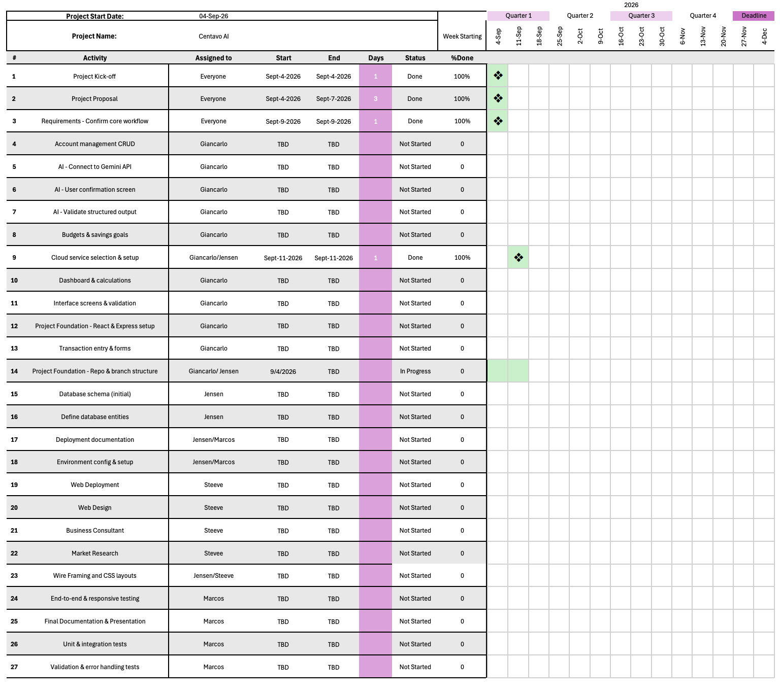
Gantt schedule and current progress
06
CIS 2910C | CENTAVO AI
Notes:
Slide 6 - Gantt Schedule and Progress
Speaker: Jensen
Explains the Gantt chart, completed work, current progress, and upcoming project tasks.

Slide 7
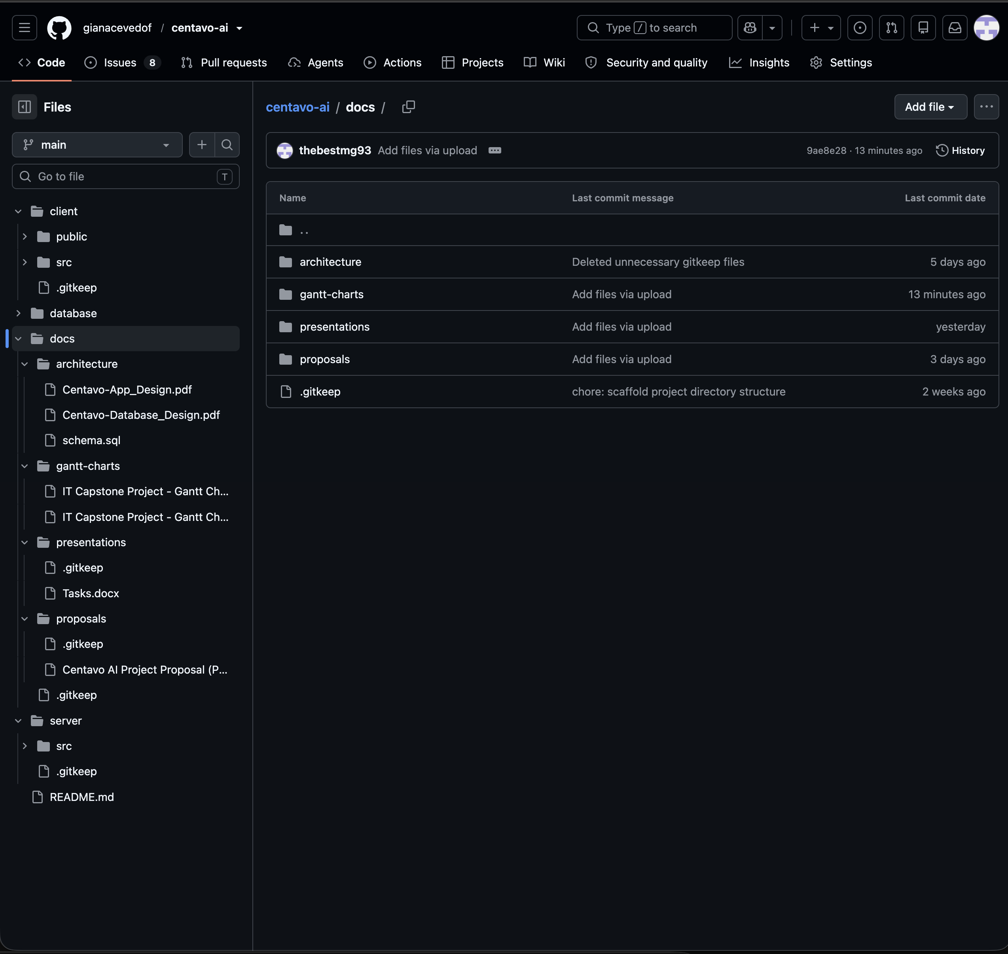
GitHub repository and documentation
07
Live demonstration
CIS 2910C | CENTAVO AI
Notes:
Slide 7 - GitHub Repository and Documentation
Speaker: Marcos
Shows where the proposal, presentation, team assignments, Gantt chart, and other documentation are stored.

Slide 8
Summary
Thank you
CIS 2910C | CENTAVO AI
Notes:
Slide 8 - Summary and Closing
Speaker: Marcos
Summarizes the main points of the presentation and thanks the audience.

